Slide 1
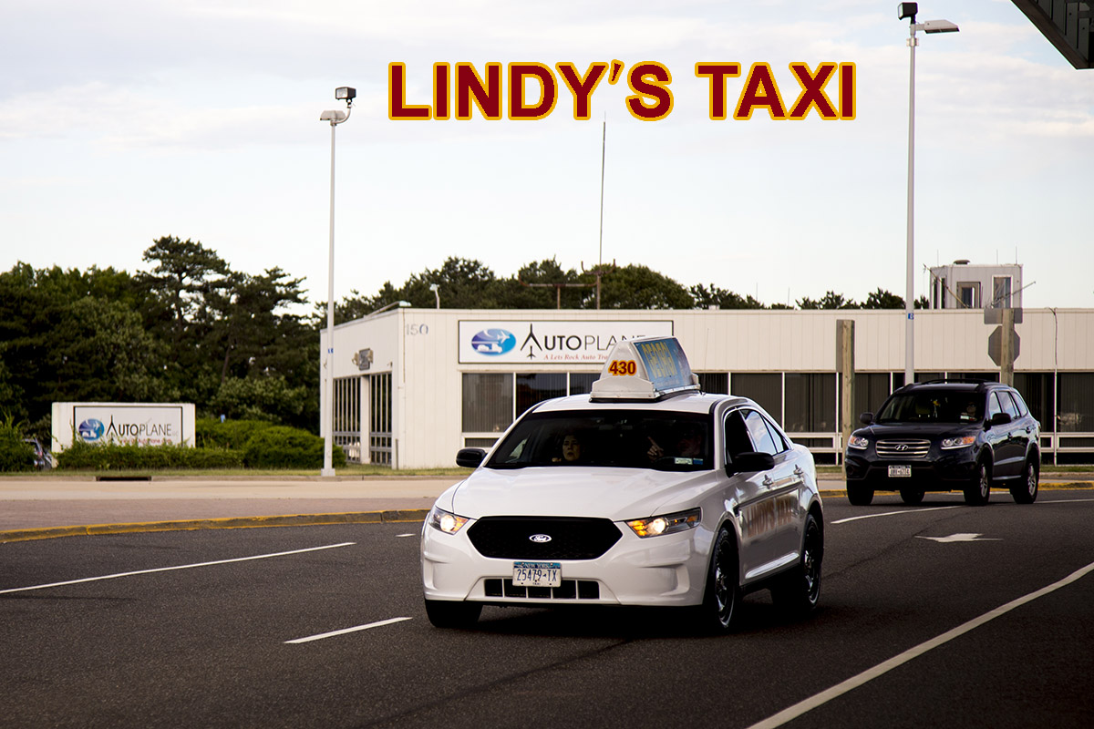
Lindy’s Taxi App Capstone
FAIQ Khan
Tariq ali
Shafiq uddin
Shohad mondal

Slide 2
Planning

Slide 3
Problem Statement
Lindy’s Taxi is a local taxi company that is based in Long Island NY. They are a very popular taxi service in Suffolk county and they have a fleet containing of about a few hundred vehicles.
Unfortunately they still use still use the classic phone reservation system. Users who are looking for a car to pick them up, have to wait on a phone line for long periods of time.
Aside from that they have to wait for the driver to pick them up. Also if a specific time has passed you may have to go back on this call line to find out where the driver is. This results in upset customers and a waste in time especially if there is an emergency situation.
This app will allow users to make a reservation/request and track drivers in real-time. On the other hand drivers can track their trips and wages for the day, month or year. Along with that this will create electronic data for the company to keep track of their driver, reservations, and their income/profit.

Slide 4
Business Case
Project Description
A new app that will allow customers of Lindy’s taxi to make a reservation and track their drivers.
Project Benefits
Electronic Records for all customers and drivers, Real-Time tracking of drivers, efficiency, cashless payment options.
Project Scope
We plan to start the project at the start of July and expect to finish mid December, right before the holiday rush. Our current system will still be in place as we are training employees to get used to the new system. Once the system is fully implemented and all employees are trained, we will begin to eliminate the current system.
Projected Financial Results
Now that the world is moving through apps, we predict that this will increase annual revenue tremendously. Due to its efficiency, Lindy’s taxi will gain more customers and keep current ones from switching.
Project Risks
The changeover process might be a little tougher than usual. Main reason is that the company is switching from a pen and paper business to an all electronic business. This might take time due to a lot of data.
Alternatives
Stick to the old system, which is a dispatcher system. One makes a call to the company and the company sends the driver. Although this is the traditional way, it is much more slower and inefficient than an app would be.

Slide 5
Project Plan
 | Task Name | Duration | Start | Finish
1 | Lindy's Taxi App | 120 days | Mon 7/3/17 | Fri 12/15/17
2 | Planning | 15 days | Mon 7/3/17 | Fri 7/21/17
3 | Present Business Case | 5 days | Mon 7/3/17 | Fri 7/7/17
4 | Present Project Plan | 8 days | Mon 7/10/17 | Wed 7/19/17
5 | Wait for approval from Management | 2 days | Thu 7/20/17 | Fri 7/21/17
6 | Analysis | 20 days | Mon 7/24/17 | Fri 8/18/17
7 | Collect Data for Data Requirements | 7 days | Mon 7/24/17 | Tue 8/1/17
8 | Collect Data for Process Requirements | 10 days | Wed 8/2/17 | Tue 8/15/17
9 | Document the steps need to implement | 3 days | Wed 8/16/17 | Fri 8/18/17
10 | Design | 15 days | Mon 8/21/17 | Fri 9/8/17
11 | Research and Create a decision matrix to find out alternatives | 9 days | Mon 8/21/17 | Thu 8/31/17
12 | Calculate the Total Cost of Ownership(TCO) | 6 days | Fri 9/1/17 | Fri 9/8/17
13 | Implementation | 70 days | Mon 9/11/17 | Fri 12/15/17
14 | Set up SQL Database | 6 days | Mon 9/11/17 | Mon 9/18/17
15 | Populate the database | 7 days | Tue 9/19/17 | Wed 9/27/17
16 | Develop the App | 20 days | Thu 9/28/17 | Wed 10/25/17
17 | Unit test the app | 4 days | Thu 10/26/17 | Tue 10/31/17
18 | Integration testing with app and database | 7 days | Wed 11/1/17 | Thu 11/9/17
19 | Systems testing | 7 days | Fri 11/10/17 | Mon 11/20/17
20 | Create product logs for Users | 2 days | Tue 11/21/17 | Wed 11/22/17
21 | Create product Logs for staff | 2 days | Thu 11/23/17 | Fri 11/24/17
22 | Train staff | 10 days | Mon 11/27/17 | Fri 12/8/17
23 | Launch App - *** Cutover | 5 days | Mon 12/11/17 | Fri 12/15/17

Slide 6
Analysis

Slide 7
Data Requirements
The database will consist of 4 main tables to store the information for Application.
1. Request – store all the info from the Client, Driver and Vehicle tables along with the time and place of pick up and drop off
2. Driver – Contains all the info about the driver including name, age, id, etc.
3. Client – Contains all the info about the client including name, pick up/drop off time and place, etc.
4. Vehicle – Contains all the info about the vehicle being used to pick up the clients.

Slide 8
Data Flow Diagram and Entity Relationship Diagram(ERD)

Slide 9
Process Requirements
Output:
Client requests, driver information (for riders and company), rider information(for drivers), Estimated pick up and drop off time, Total payout breakdown.
Inputs
Riders and Driver can setup account, with an email and password on the App, Rider can create new reservation through app, Update and change existing reservation, Payment options (gift cards, credit cards, etc), Rider can store favorite pick up/drop off locations
Processes
Java for Android platform and Swift for iOS, MS SQL for databases, Reservation will be made through app portal will update and store information for each ride.
Performance
This app will allow many riders to simultaneously request pick and drop, drivers will have small to no downtime, Proficiency and Availability will create reliable service for riders and drivers.
Control
Riders and drivers will have unique user ID and password linked to their personal email address. Email addresses will be validated on account creation. All traffic will be transmitted through SSL for encryption. This will ensure any data passed between the webserver and the client device will remain secure. SSL is the industry standard for protection in online transactions. Rider credit card information will be stored by the database or in the user accounts, and will require pin to order ride. May have option to disable the pin.

Slide 10
Design

Slide 11
Total Cost of Ownership(TCO)
Acquisition Costs | Lindy's Taxi App | Old System
Software Application | $0 | $0
Hardware Server | $10,000 | $5,000
Software OS | $3,000 | $0
Installation | $10,000 | $0
Data Migration | $10,000 | $0
Application Customization | $5,000 | $5,000
Testing | $10,000 | $10,000
Total Acquisistion Costs | $48,000 | $20,000
Annual Operating Costs | Lindy's Taxi App | Old System
User Fees | $14,000 | $0
Support Fee | Included | $15,000
Hardware Maintenance | $0 | $1,000
Software Maintenance | $1,500 | $500
Operations | $0 | $8,650
Environmental(Power & Cooling) | $0 | $2,000
Total Operating Costs | $15,500 | $27,150
Total Cost of Ownership | Lindy's Taxi App | Old System
Acquisition Costs | $48,000 | $20,000
Operating Costs (3 Years) | $46,500 | $81,450
TCO - 3 Years | $94,500 | $101,450
Looking from a financial stand point of view, the Lindy’s Taxi App is the most cost effective as compared to keeping the old system (leaving it as it is). It’ll be the most beneficial system in terms of revenue too, as we will not face any problems of long waiting of customers for the rides they ordered (result in getting more customers rather than losing them).

Slide 12
Decision Matrix
We want to create Lindy’s Taxi App (Option 1) for our customers, so they don’t face any problems while booking or reserving the ride.
We compared it with UBER App, as our proposed App is going to perform very similar UBER. Reason for that is we want to be on top of the new business and technology trends.
We also compared it with the current system, which does not address the issue of: customers waiting long for their rides, leave the company with losing more customers rather increasing them.
Option |  | (Lindy'sTaxi)App |  | UBER |  | PhoneCalling
Feature | Importance | Rating | Score | Rating | Score | Rating | Score
Automated System | 8 | 9 | 72 | 9 | 72 | 4 | 32
Booking/Reservation | 10 | 10 | 100 | 10 | 100 | 6 | 60
Safety | 7 | 9 | 63 | 9 | 63 | 6 | 42
Time | 9 | 10 | 90 | 9 | 81 | 5 | 45
Profit/Cost | 10 | 9 | 90 | 9 | 90 | 7 | 70
FAQ | 7 | 8 | 56 | 8 | 56 | 6 | 42
Totals |  |  | 471 |  | 462 |  | 291

Slide 13
Implementation

Slide 14
Implementation Plan
Coding:
The SQL database – setup and population will start on 9/11/2017 and it will take about 13 Days]
The mobile application will be created to be cross-platform for both iOS and android and will be coded using iOS Swift and java respectively. Development will begin on 9/28/17 and it will take about 20 days.
Documentation:
A user manual will be created for both drivers and passengers. The manual will address: account creation, application usage, functionality specifics and troubleshooting. It will go into detail on how to use the application as either a passenger or a driver.
Developers will be responsible for keeping a changelog of the application.
Testing:
Testing will total 18 days starting 10/26/17. The mobile application will be vigorously unit tested upon creation. Following suit will be integration testing between modules such as payment processing and the application. Testing will conclude with an entire system test to polish the application.
Training:
Training phase will commence once a branch is selected to implement the system. Over the course of 10 days, starting 11/27/17 employees will be given manuals and instructed on application usage.
Change over:
The system will be implemented through piloted operations to reduce risks during changeover.
Branches will be selected and training will be done systematically. Scheduling implementation will ensure that the application will be used consistently throughout all branches. The changeover period will last 5 days, finishing on 12/15/17
Go Live!
Application will be ready to go live on 12/15/17. We hope to use the holiday rush to our advantage. Following the launch, we will begin an ad campaign to promote the service. We will buy ad-space on various websites and promote deals to draw a consumer base.

